Slide 1
Welcome to Arusha!
Paula Hunter, Executive Director
Mojaloop Community Meeting - April 2022

Slide 2
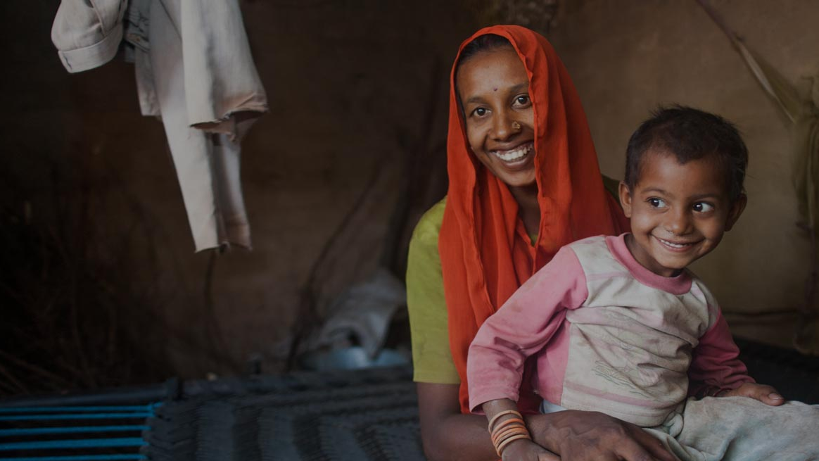

Everyone Benefits
From an Economy that
Includes Everyone
How Can Mojaloop Help?
Inclusive, Interoperable, Real-Time Payments
Notes:
Paula Hunter:
Thank you, Kosta. I thank you all for joining us today to hear more about Mojaloop, and the Mojaloop Foundation. I think what I would like to start with here today is to emphasize that Mojaloop is an Open-source Software tool kit, that's designed to enable interoperability across payment service providers.
So, it important to remember that anyone is free to download the software, test it, kick the tires, and deploy it, anything you like, without paying a license fee. For the techies in the audience, we encourage you to visit our GitHub repository and dive right in and get to know the platform. But more on that later.

Slide 3
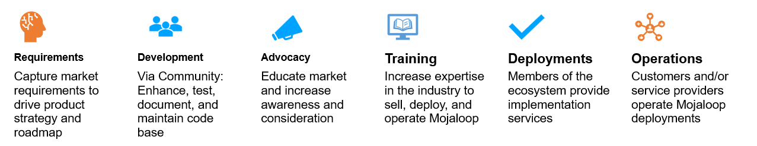
The Role of the Mojaloop Foundation
Operates as a 501(c)(3) charitable organization and maintains its free, opensource software and community as a public goods in service of financial inclusion.
Focus on expanding the work the Mojaloop project initiated in Africa, expanding engagement where there is the greatest opportunity to directly affect financial inclusion through interoperable payments.
Engage with digital financial service providers, regulators, NGOs and governmental offices looking to address the critical challenges faced by local underserved communities.

Slide 4
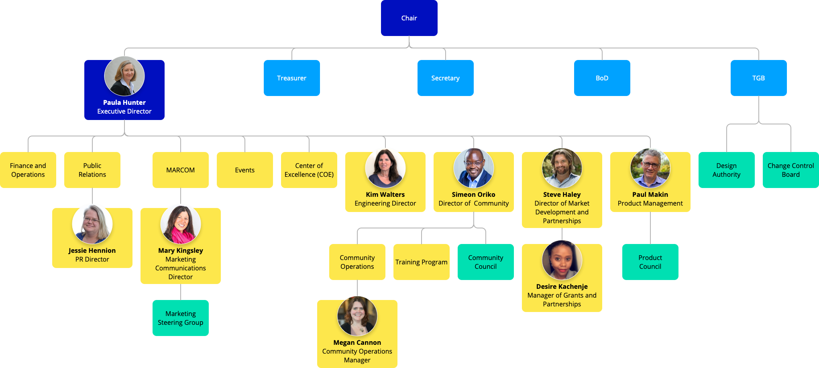
The Mojaloop Foundation

Slide 5
Increase Adoption of Mojaloop Technology
Mojaloop Foundation
CY2022 Priorities
Why
The way to achieve or mission
How
Find additional partners to support deployments
Have a clear path for funding new deployments
The rationale for further investment in the Mojaloop Foundation
Engage strategic partners

Slide 6
Identify Grants / Funding for Deployments and Projects
Mojaloop Foundation
CY2022 Priorities
Why
Reduces barriers for central banks that may not have funds for new projects
How
Active program to prioritize targets, engage (sell), secure, and administer grants
Signal to the market that there is business opportunity with Mojaloop
Fund special projects

Slide 7
Expand Membership > Community Engagement
Mojaloop Foundation
CY2022 Priorities
Why
Increases contributions to development efforts
How
Prioritize targets - Technology fit, market and geographic match, mission alignment
Reduces dependency on funded development
Increases credibility
Dues helps fund operational expenses

Slide 8
What are your long-term priorities?
Technology | Building Capacity
Business| Project Funding …

Slide 9

Mojaloop Foundation’s Wholesale CBDC Initiative
Form “CBDC Center of Excellence”, headquarters: Singapore
Open-source project, starting with the hiring of CBDC COE staff
COE Director, Engineering Director, Community Manager, DEV/OPS specialist
Ongoing push for new MLF members and funding sponsors of project
CBDC Working group to be launched
Open to all for participation and contribution
Governance of WG overseen by MLF Member companies and funding partners
Scope of project drafted, WG to provide next level of details

Slide 10



The Promise of CBDCs
CBDC reduces the reliance on banks and other financial institutions. It can be the medium that fosters the financial inclusion of the underserved populace.
Can be universally accessible and widely used
Accelerate aid payments (G2P)
CBDCs reduce dependence on physical cash, thereby making the distribution of money more efficient
CBDCs may be cheaper than other digital financial services

Slide 11




Mojaloop and Wholesale CBDC – Beyond the Code
Identify pilot projects aligned with our focus
Participate in financial inclusion workshops and hackathons
Collaborate on the development of a CBDC toolkit
Mojaloop Slack Channel: #wholesale-cbdc

Slide 12
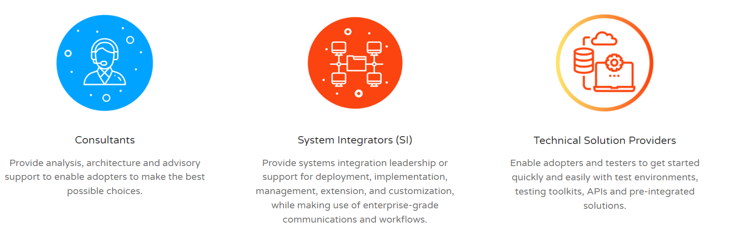
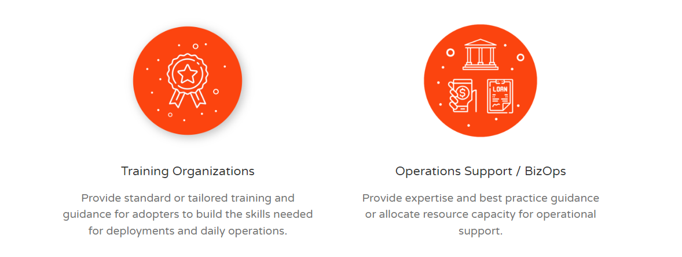
Business Directory
The directory makes it easy for Mojaloop adopters and others to identify contacts that are able to respond to their inquiries.
Mojaloop Business Directory Registration: https://mojaloop.io/mojaloop-business-directory/

Slide 13
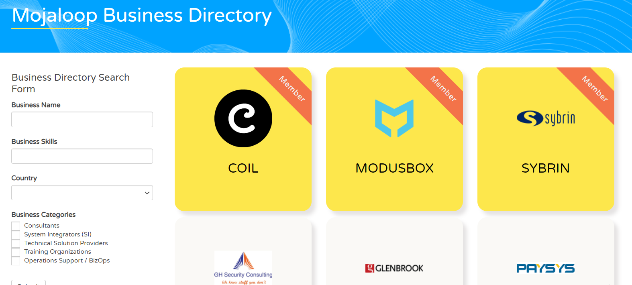

Business Directory

Slide 14
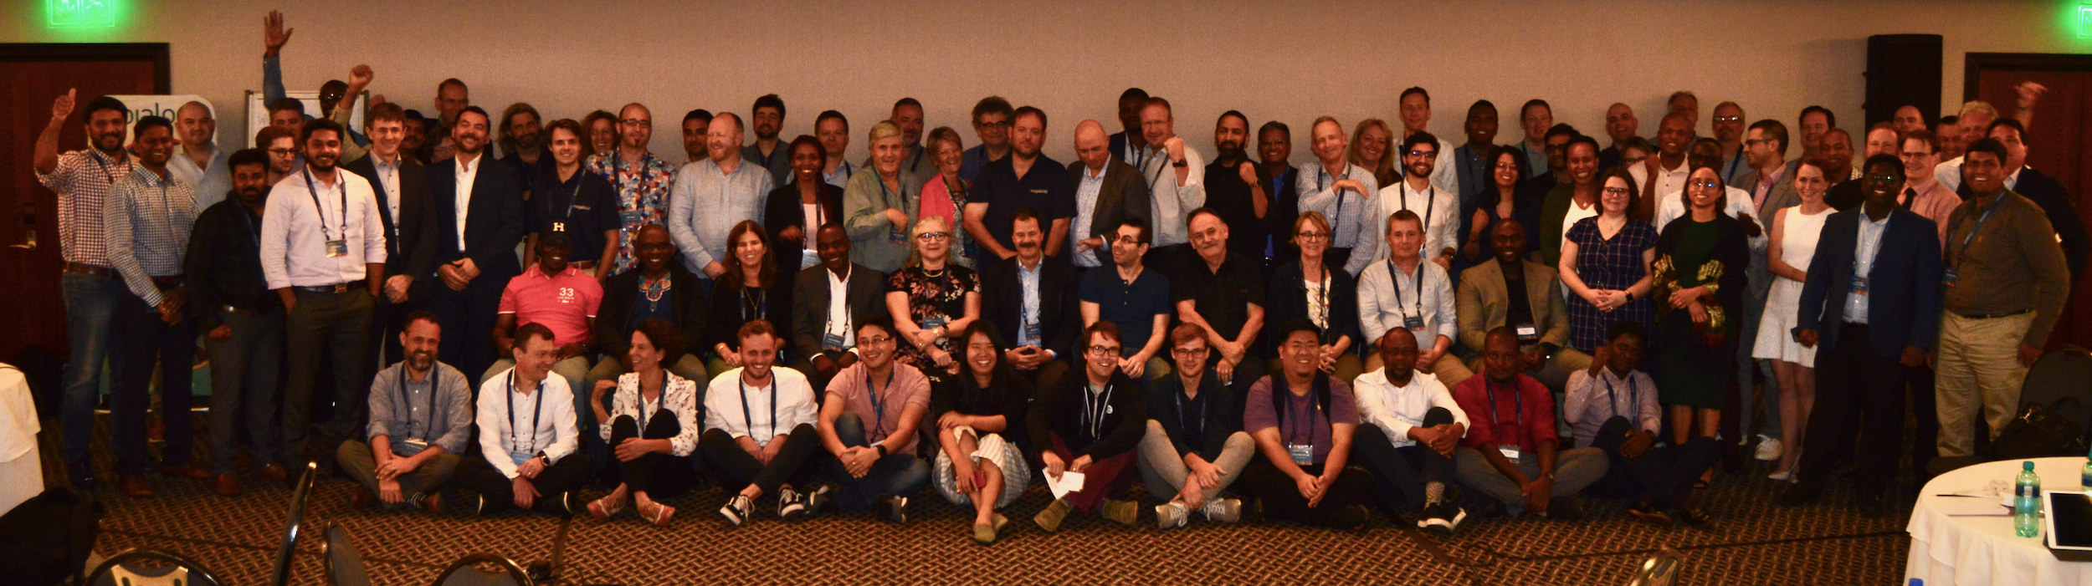
The Role of the Mojaloop Community
Mojaloop works with different organizations to provide a vibrant ecosystem of solutions to facilitate deployment, customization and extension of the software.
It takes a village!

Slide 15
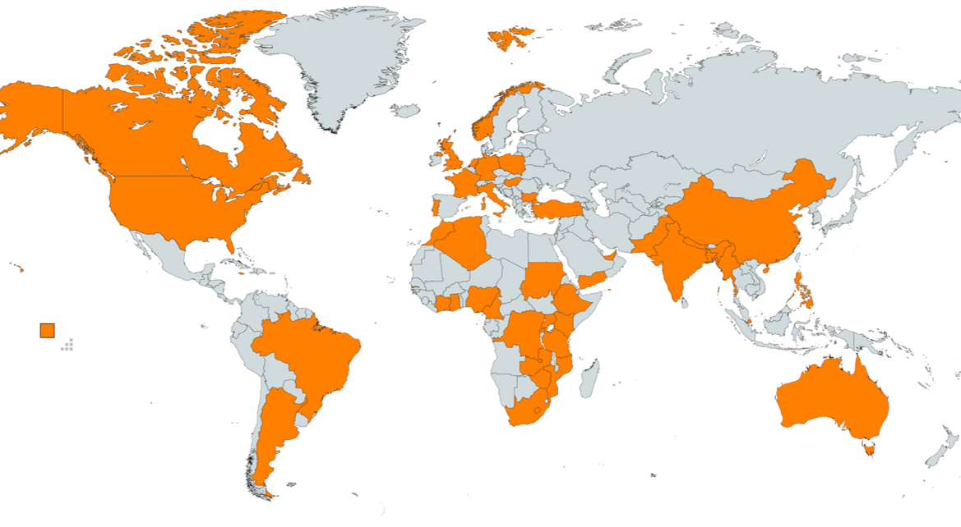
Thank you for your participation!
January Member Meeting
194 registrants ~ 50 countries ~ 6 continents
81 who have not registered for CMs in the past

Slide 16
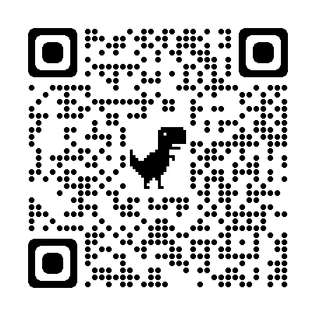
What are your long-term priorities? Please let us know!
Technology | Building Capacity
Business| Project Funding …
https://www.surveymonkey.com/r/FBT8LL7

Slide 17
Thank you!
Have a great meeting.
phunter@mojaloop.org

